Slide 1
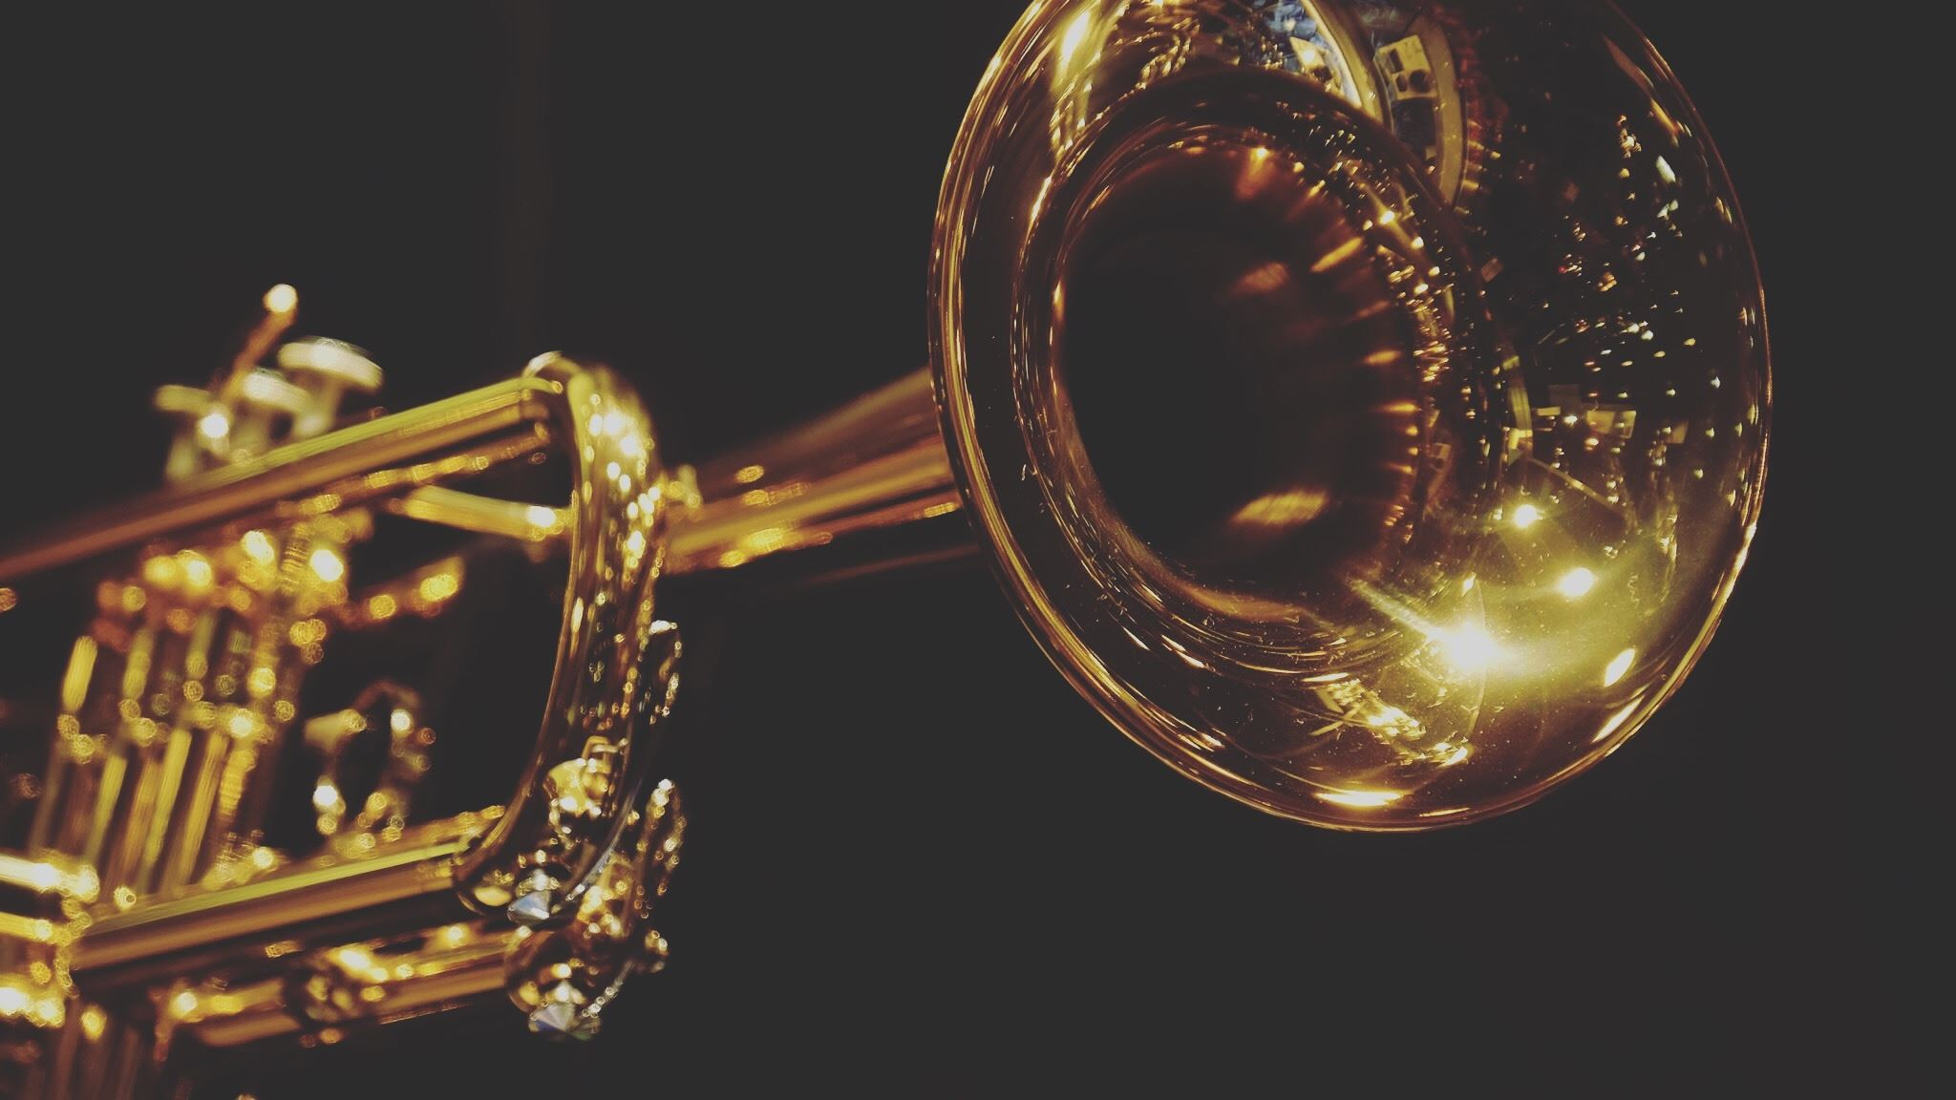
Year 6: Light
For parents
Thank you for supporting your child’s learning in science.
Before the session:
Please read slide 2 so you know what your child is learning and what you need to get ready.
As an alternative to lined paper, slide 5 may be printed for your child to record on.
During the session:
Share the learning intentions on slide 2.
Support your child with the main activities on slides 3, 4 & 5, as needed.
Slide 6 is a further, optional activity.
Slide 7 has a glossary of key terms.
Reviewing with your child:
Slide 8 gives an idea of what your child may produce.
Seeing shiny and matt objects
Year 6 Age 10-11

Slide 2
Light
Seeing shiny and matt objects
Key Learning
The idea that light travels in straight lines can explain how non-luminous objects are seen.
All surfaces reflect some light.
Shiny surfaces reflect light better than matt surfaces.
Activities (pages 3-5): 30 - 40 mins
Household items to support learning:
a torch
objects around your home
Use lined paper, a ruler and a pencil for recording. Alternatively you may wish to print page 5 as a worksheet.
Find out more… (page 6)
You may like to research and explore mirrors further (using a spoon, mirror or your toys).
You might like to model how light reflects from a mirror using a football and chalk/string in a paved area outside.
I can…
record the results of a reflection investigation in a Carroll diagram.
draw ray diagrams to show how non-luminous objects are seen directly, and when they are seen reflected in a mirror.

Slide 3
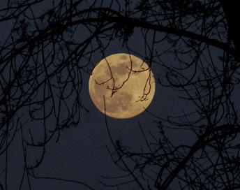
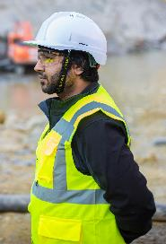
Explore, review, think, talk…
What do you already know about the reflection of light?
(10 minutes)
Jot down a list of the following and talk or think about what they are made of:
Five shiny objects (e.g. a metal spoon)
Five matt objects (e.g. a piece of paper)
Five luminous objects (e.g. a candle)
Think or talk about whether each of these is luminous or a good reflector?
You could watch www.bbc.co.uk/bitesize/clips/zs3ygk7
Shiny objects are often made of metal or have a metal layer covered by clear plastic or glass. Some polished or very smooth objects such as crystals are shiny. Shiny objects reflect most light that hits them in a particular direction.
Matt objects are less good reflectors of light than shiny objects as they absorb some of the light energy. Their surfaces are less smooth than those of shiny objects, so the light they reflect scatters in all directions.
Luminous objects are light sources.
The moon, hi-vis jacket and cat’s eyes are all excellent reflectors; they do not emit light.

Slide 4
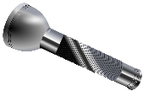
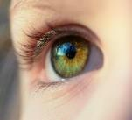
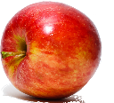
Light
Investigate the reflective properties of objects
(20 - 30 minutes)
Investigate reflection by shining a torch on various objects/surfaces around the room to see how bright the circle of light looks on each of them. You could investigate one of these:
If smooth surfaces are always more reflective than rough ones?
If white/pale surfaces are always more reflective than black/dark ones?
If some surfaces reflect equally brightly when the torch is held at different angles to them, or not?
You could try black and white paper or t-shirts, a mobile phone screen, carpet, shiny paper, mirrors and plastic of different colours/textures.
Record your results using a Carroll diagram (see next page) to group your data according to the ‘yes/no’ question you investigated and how reflective or not the objects/surfaces were.
In each test, light travelled from your torch, reflected off an object and then travelled into your eye. In each part of its ‘journey’ the light travelled in a straight line.
A ray diagram showing reflection

Slide 5
Label your Carroll diagram to match the question you are investigating. For example ‘Smooth’ vs. ‘Rough’, ‘White/pale’ vs ‘Black/dark’ or ‘Reflects better…’ vs. ‘Reflects equally…’
Write the name of each object or surface you tested in a square of the Carroll diagram. For example, for a smooth/rough test, ‘mirror’ would be in the top-left square.
Draw a ray diagram showing how light travels to enable you to:
1) see a toy teddy, and 2) see the reflection of a toy teddy in a mirror.
I can record the results of my reflection investigation in a Carroll diagram
I can draw ray diagrams to show how non-luminous objects are 1) seen directly and 2) when they are seen reflected in a mirror
Label this 🡪 for your investigation | (Choose one of: ‘Smooth’, ‘White/pale’ or ‘Reflects more light in some directions than others’) | (Choose the opposite! - ‘Rough, ‘Black/dark’ or ‘Reflects equally in all directions’)
Reflective
Not very reflective

Slide 6
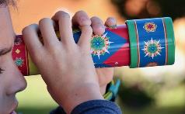
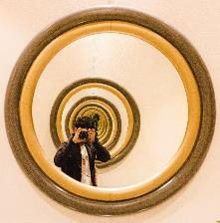
Find out more…
Find out more about the reflection of light
(Optional)
Find out more about mirrors. You could:
Explore reflection from non-flat mirrors using both sides of a spoon held at various distances.
Investigate any toys you have with mirrors – e.g. a periscope or kaleidoscope.
Try to create an infinite tunnel using two parallel mirrors. How does it work?
Research what is special about the angles when you get reflection off a mirror.
Try this…www.beano.com/games/lazer-maze
Watch this BBC Bitesize clip about reflection www.bbc.co.uk/bitesize/topics/zbssgk7/articles/ zqdxb82
Model reflection of light in a mirror, by kicking a football slowly from your patio or yard against a smooth wall at different angles. You could use chalk or markers to show where you kick from, where the ball hits the wall and where it goes next. You could mark the path of the ball using chalk or string and use a protractor to work out the angles involved. Don’t forget to take a photo!
Just before bedtime, test whether it’s easier to see reflective things when its dark.

Slide 7
Glossary of terms
Carroll diagram: A Carroll diagram is a way of grouping data according to whether it fits certain criteria.
light: Light is the form of energy that makes it possible for us to see things with our eyes.
light source: A light source emits (gives out) light. It can be natural or man-made.
luminous: A luminous object emits light, whereas a non-luminous object reflects it.
matt: Matt surfaces look dull and not shiny.
mirror: A mirror reflects a clear image, with almost all the light bouncing back.
ray diagram: A ray diagram is a drawing showing the straight-line paths that light travels in from a light source to the eye, often reflecting off objects on the way.
reflect: Light reflects when it ‘bounces back’ off a surface or object. All objects reflect some light otherwise we couldn’t see them.
scatter: If a light ray scatters it changes direction to a different random direction.
shiny: A shiny surface reflects most light that reaches it.
straight lines: A straight line continues in the same direction and does not curve.
surface: A surface is the outside or top layer of something.

Slide 8
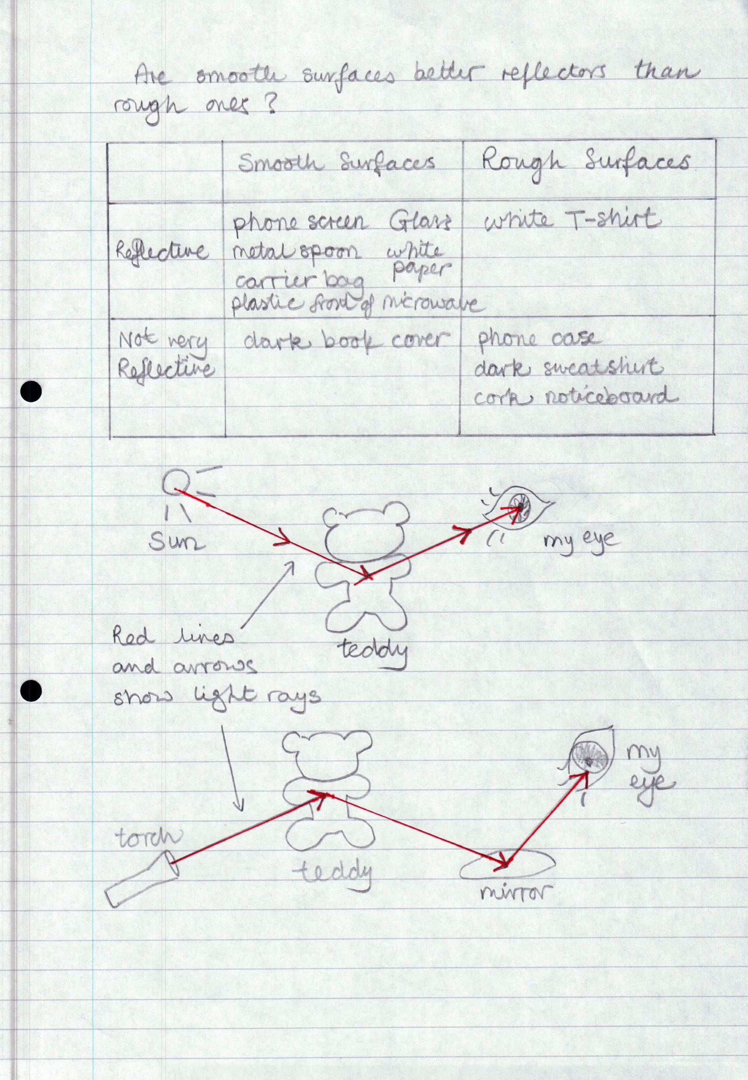
Possible learning outcome for reviewing your work:
I can record the results of my reflection investigation in a Carroll diagram.
I can draw ray diagrams to show how non-luminous objects are seen directly and when they are seen reflected in a mirror.
The header row of the Carroll diagram should have matching labels for the chosen investigation
‘Smooth’ and ‘Rough’
‘White/pale’ and ’Black/dark’,
‘Reflects more light in some directions than others’ and ‘Reflects equally in all directions’.
You will probably find that:
Smooth surfaces are usually reflective and rough surfaces are not very reflective.
White/pale surfaces are usually quite reflective and black/dark surfaces are not.
Mirrors and shiny surfaces are reflective and reflect more light in some directions than others. Matt surfaces are not very reflective and reflect (or, in reality, scatter) light equally in all directions.
Another light ray should travel in a straight line into the eye in both diagrams.
Don’t worry about the angles between any of the light rays.
The first light ray should travel in a straight line starting at the light source and travelling to the object.
This diagram is very like the first one, but with a mirror added between the object and the eye.

